Slide 1
Technology Forum

Slide 2

Agenda
  Carbon Journey
    Secaro (M2030)
  Source To Settle
    SAP Business Network

Slide 3

SBTi Commitment
Confidential
People
Haworth commits to reach net-zero GHG emissions across the value chain by 2050.
2030 Near-Term Targets
Haworth commits to reduce absolute scope 1 and 2 GHG emissions 60% by 2030 from a 2021 base year.
Haworth also commits to reduce absolute scope 3 GHG emissions from purchased goods and services, upstream transportation and distribution, and end of life treatment of sold products 42% in the same time frame.
2050 Long-Term Targets
Haworth commits to reduce absolute scope 1, 2 and 3 GHG emissions 90% by 2050.
Circular Economy
Operational Performance
Notes:
We are proud to be the first in our industry to have validated Net-Zero targets by SBTi.

Slide 4
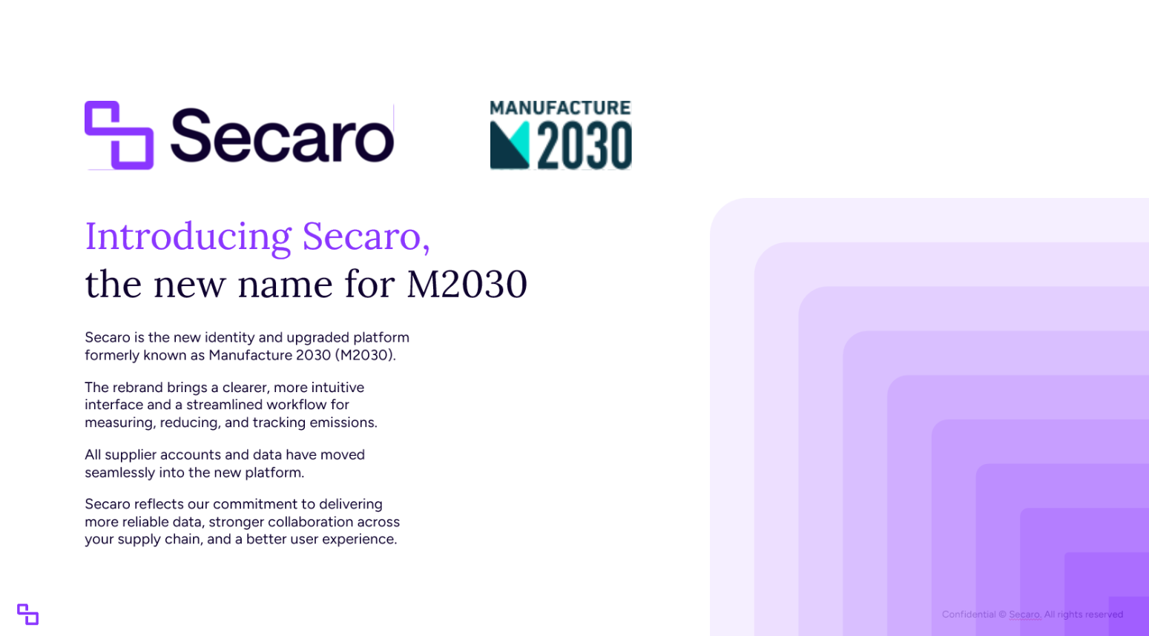

Slide 5
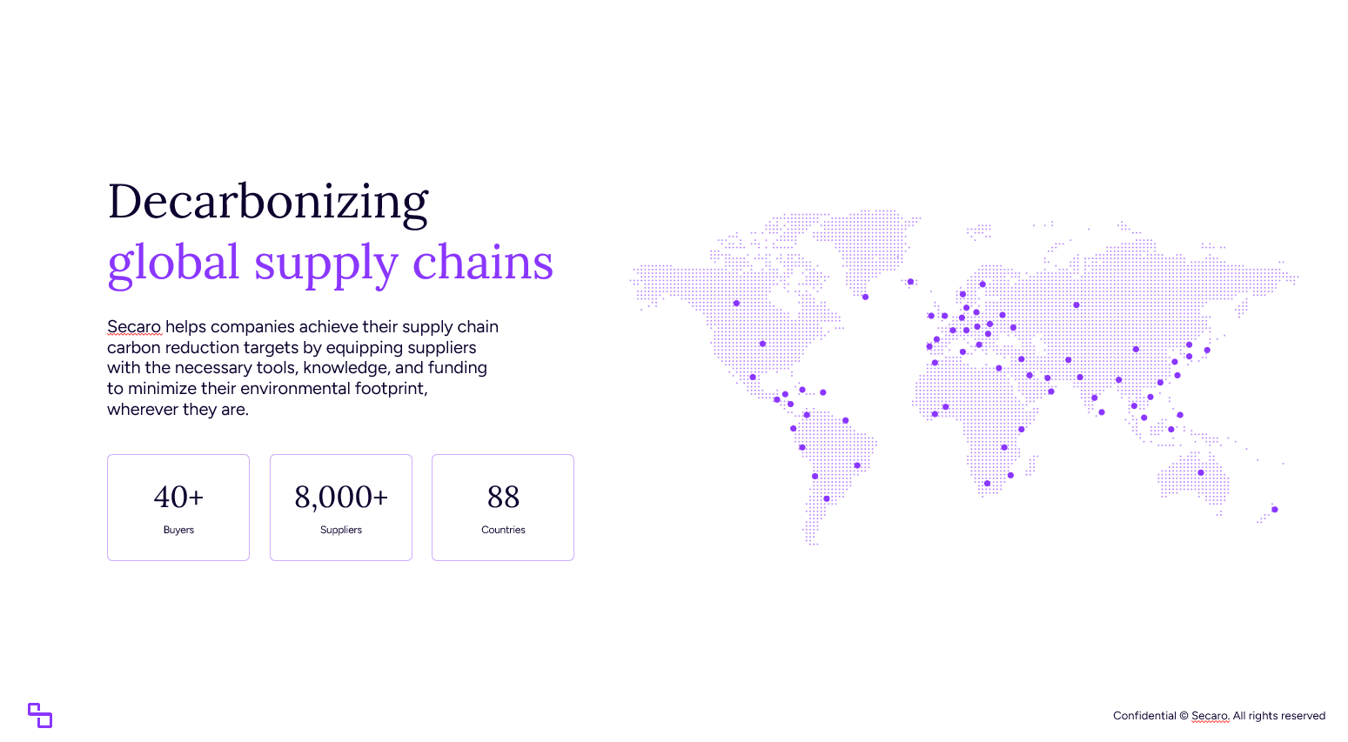

Slide 6
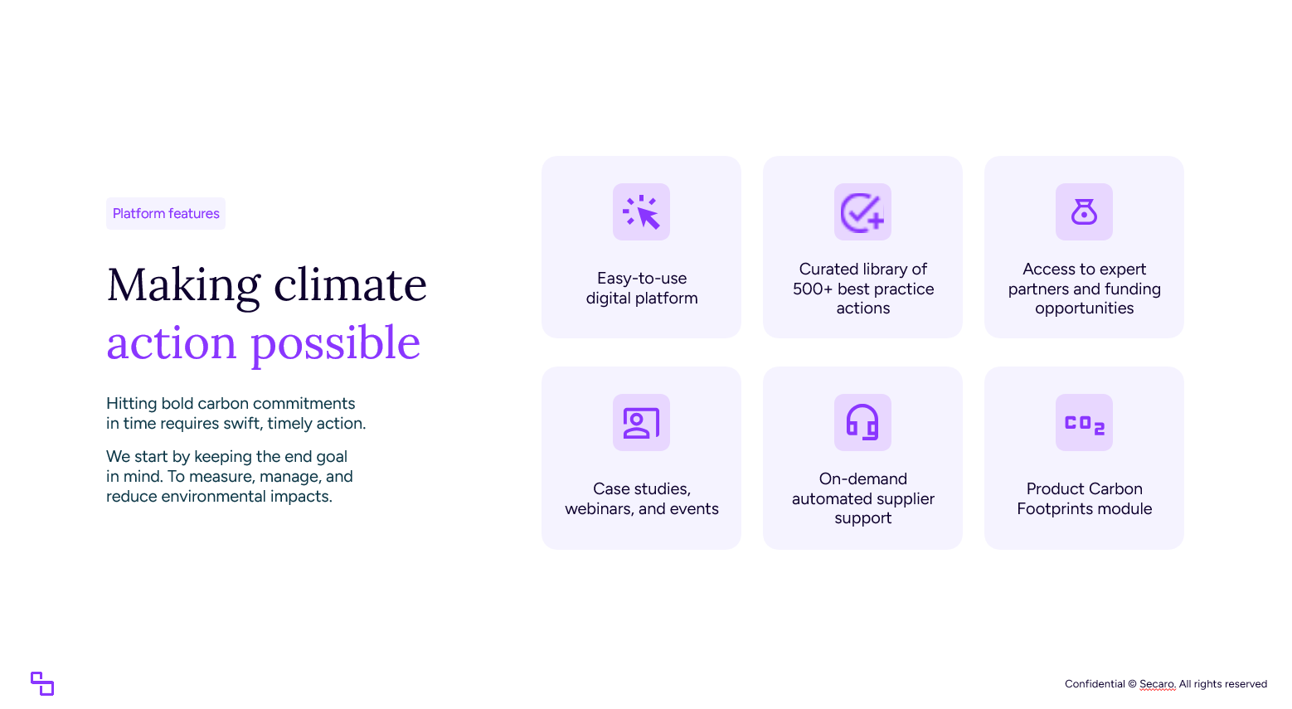

Slide 7
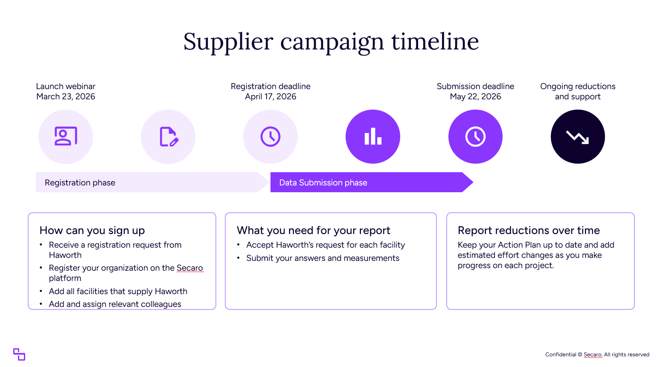

Slide 8

If you have any comments or questions, please use the Q&A function at this time and we will respond at the end of the session
Should you have any additional questions once the session is over, please contact your Haworth Purchasing Representative

Slide 9

Source to Settle
”Driving efficiency through the implementation of SAP Business Network at Haworth”
Dec 2, 2025

Slide 10
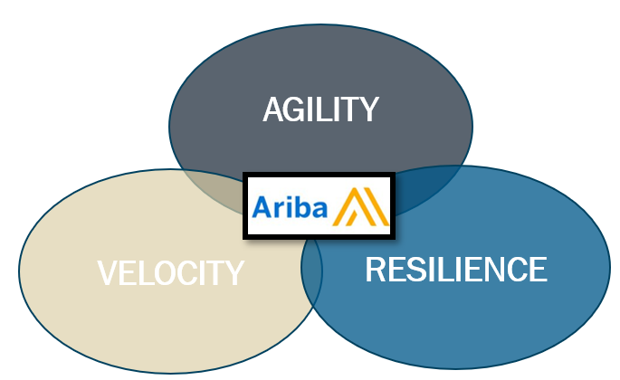

Source to Settle | Why are we on the Journey
Current State at Haworth
Future State at Haworth
Improves Timely Communication
Avg 50% reduction in quote lead time
Automation of 40K keyed invoices
Repositioning work to value-added deliverables
Increases spend visibility
Automated workflows
Internal
End-of-life purchasing systems
Significant human intervention
No Purchase Order Confirmations
Inadequate Advanced Shipping Notice
Inefficient Procure to Pay Processes
Lost Knowledge Base — Turnover
External
Geopolitical Dynamics
Supply Chain Interruptions
Pace of change with our Customers
Expected Outcomes
Increased Customer &
Supplier Satisfaction:
“easier to do business with…”
Improved Member Engagement
Incremental EBIT
Aligned Technology Roadmap
Reduced Risk--Financial, Technological, Compliance

Slide 11
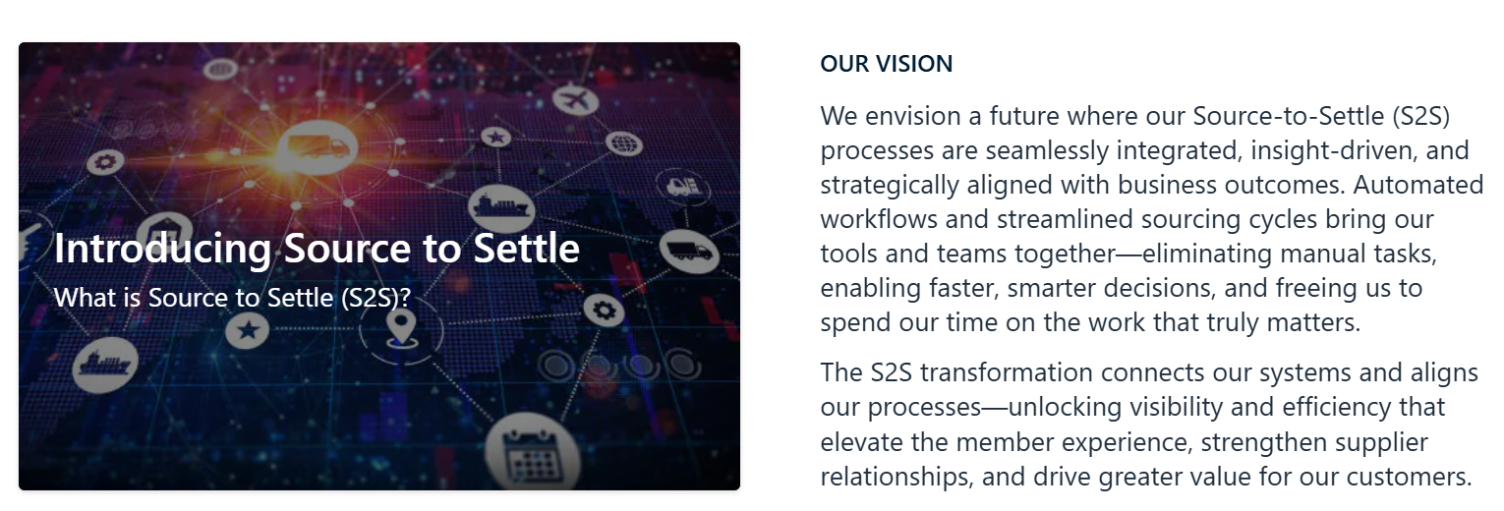

Slide 12


Slide 13










Intelligent Spend Management Solution Overview
Comprehensive capabilities aligned with Haworth’s technology roadmap
Supply Chain Business Network
SOURCE
PLAN
PROCURE
PAY
Spend Analysis
Supplier Management
Guided Sourcing
Contract Management
Forecast and Scheduling
Inventory Collaboration
Procurement
Order Execution
Invoice
Cash Management
Spend Classification
Category Management
Enrichment Services
Market Intelligence
D&B Insight
Spend Analytics
Registration and On-Boarding
Diversity and Green Certs
Risk Management
Surveys
Scorecards
Performance
Sourcing Pipeline
Supplier Discovery
Strategic Sourcing
Reverse Auctions
Knowledge Repository
Optimization
Award-Contract
Workflow
Authoring
Repository
Lifecycle Notifications
Redlining
E-Signatures
Forecast sharing
Forecast Commit
Exception Management
Scheduling Agreements
Releases
Inventory Visibility
Consignment Collaboration
Supplier Managed Inventory (SMI)
Quality Collaboration
Guided Buying
Material and Services
Catalogs & Spot Buy Marketplace
Workflow Approvals
Supplier Registration and On-Boarding
Mobile Ordering
Confirmations
Advanced Ship Notice
Goods Receiving
Rate Card Management
Returns
Global E-Invoicing
Invoice Automation
PO Flip
Invoice Reconciliation
ERS
Tax Service
Terms Management
DPO Extension
Dynamic Discounting
Electronic Payment

Slide 14








The Value Add of SAP Business Network
From Tactical
to Strategic
Impacts
Member Satisfaction
Risk Management
Customer & Supplier Satisfaction
EBIT

Slide 15
Example - Order Confirmation
Increased Customer Satisfaction
Current
Process:
Multiday time-intensive, manual
Assumptive reasoning
Modes of Resolution:
Insulated visibility – Emails, Phone
Experiential Knowledge
Suppliers
PO Issuance
PO Delivery
PO Delivered
Yes
Ship to Customer
No
Customers
Delays to customers
Unknown until Missed PO
Process:
Real-time, automated
Confirmations, End-to-End Connectivity
Modes of Resolution:
Systematic visibility – Supplier, Customers, Members
Exception Management
Future
Suppliers & Customers
PO Issuance | PO Confirmation | Shipping Notice | PO Delivered
Ship to Customer

Slide 16
Benefits and Timing
Notes:
This section outlines the communication timeline, how suppliers will receive invitations, and the availability of training and support resources throughout the transition.

Slide 17

SAP Business Network Benefits
Secure Digital Environment
  The platform ensures secure transactions by protecting sensitive source to settle data from unauthorized access.
Transaction Accuracy
  Automated processes improve transaction accuracy by minimizing manual data entry and errors.
Real-Time Transaction Visibility
  Suppliers gain instant visibility into transactions, enabling timely decisions and better monitoring.
Faster Processing Times
  Improved systems accelerate transaction processing, reducing delays and boosting efficiency.
Notes:
Benefits will be determined based on how the supplier uses Ariba (B2B vs. Portal)
---
SAP Business Network will simplify purchase-to-pay activities by providing a secure, digital environment that enhances transaction accuracy and reduces manual errors.
Image source: Microsoft 365 content library

Slide 18

Supply Chain Collaboration
What is Supplier Chain Collaboration (SCC)?
SCC fosters flexible collaboration between buyers and suppliers within SAP Business Network, enhancing visibility and facilitating collaboration with various partners in the supply chain.
Customer Benefits: | Supplier Benefits:
Efficient supply chain management. | Reduced latency and improved forecast accuracy.
Reduced inventory levels and mitigated disruptions. | Enhanced on-time delivery and flexibility.
Prevention of revenue loss through stock-outs. | Minimized manual intervention in processes.
Automated data exchange.
Notes:
Supply Chain on SAP Business Network streamlines collaboration between trading partners. It gives everyone a clear view of the supply chain, allowing better teamwork with component and raw material suppliers, contract manufacturers, subassembly partners, and logistics providers.
By using SCC, your customer can manage their supply chain more effectively. Inventory levels go down, disruptions are less of a problem, and stock-outs become less likely. Plus, data exchange is automated, saving time and effort.
For you, using SCC with your customer means faster response times, more accurate forecasts, better on-time delivery, and less manual work.

Slide 19


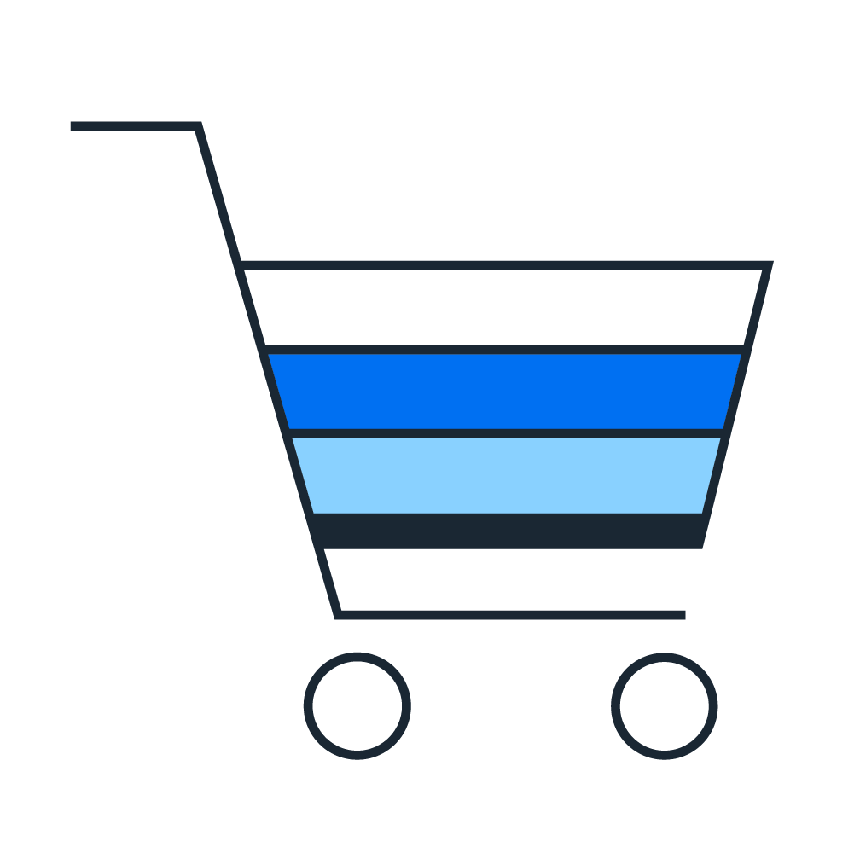

Supplier Registration vs. Transactional Business Network
Registration and Compliance
Haworth Sourcing and Contracts:
Haworth will require suppliers to
use Business Network for:
Receive
Purchase
Orders
Send electronic documents
Registration in SBN and Compliance Documents
Request for Proposals
Contracts
Notes:
Before we cover the concrete next steps, I would like to highlight both ways that Haworth is using SAP Business Network. We are utilizing the platform for Sourcing and Contracting for purposes like Requests for proposals and contracts. The Business Network itself is being used for transacting electronic documents such as Purchase Orders, Order Confirmations or Invoices. Here you can also establish electronic catalogs with Haworth. You won’t need two accounts for using both functionalities, you can manage everything via one SAP Business Network account. Following we will describe what steps to take to connect with Haworth on the SAP Business Network.
ADD NOTE: IF THE SUPPLIER CHOOSES TO USE THEIR EXISTING SLP ACCOUNT, THEY MUST UPGRADE TO AN ENTERPRISE ACCOUNT TO USE WITH HAWORTH.
DOING SO COULD IMPACT OTHER CUSTOMER RELATIONSHIPS IN THAT ACCOUNT.
Per Haworth sourcing, if a supplier has not completed their registration they cannot move forward with TRR and transacting…..

Slide 20





Our Implementation Partners
Implementations
Services
Experience
Business Acumen
100+ SAP Ariba Customers
175+ years of combined direct SAP experience
Ariba Enterprise Deployment
Change Management Expertise
Application Management
20+ years of experience
1,500+ Customers
1,700+ team of practitioners
Typical Consultant has 15+ years of business and software experience
Deep understanding of business processes, business models & value extraction methodologies
Deep understanding of value chain and industry economics
SAP Ariba Practice Overview
Resources
Delivery
Knowledge
Architecture
Procurement Transformation projects through improvements across the Value Stream that drive significant ROI
Experienced SAP resources with Solution Certifications and multiple successful projects
Ability to analyze disparate data sets and derive actionable insights
Knowledge & experience with key SAP products / solutions and detailed processes
Enterprise
Business
Solution
Data
Delivering the integrated suite of SAP Ariba Source-to-Pay applications through best practices and superior product knowledge.
Scope: e-Sourcing, Contract Management, Supplier Management, Risk modules, Buying & Invoicing, AP Automation
Scope: PO Collaboration plus bar code labels (Direct), Subcontracting, Supplier Managed Inventory, Forecasting, Consignment, Contract Manufacturing

Slide 21

Overview of Phases
Phase 1: Building the Foundation
Set up the software and data, enabling sourcing module which include Sourcing Event capabilities, supplier registrations and ongoing management through the Ariba network.
Phase 2: Buying and Invoicing and Foundational Supply Chain Collaboration
Focuses on indirect and direct stock purchasing, supplier collaboration for PO confirmations (dates and quantities), ASN processing, handling unit management, and supplier labeling capabilities.
Phase 3: Advanced Supply Chain Integration
Expands into strategic inventory models including consignment, vendor-managed inventory (VMI), inventory visibility and collaboration, 3rd-party warehouse management, and advanced subcontracting processes.

Slide 22
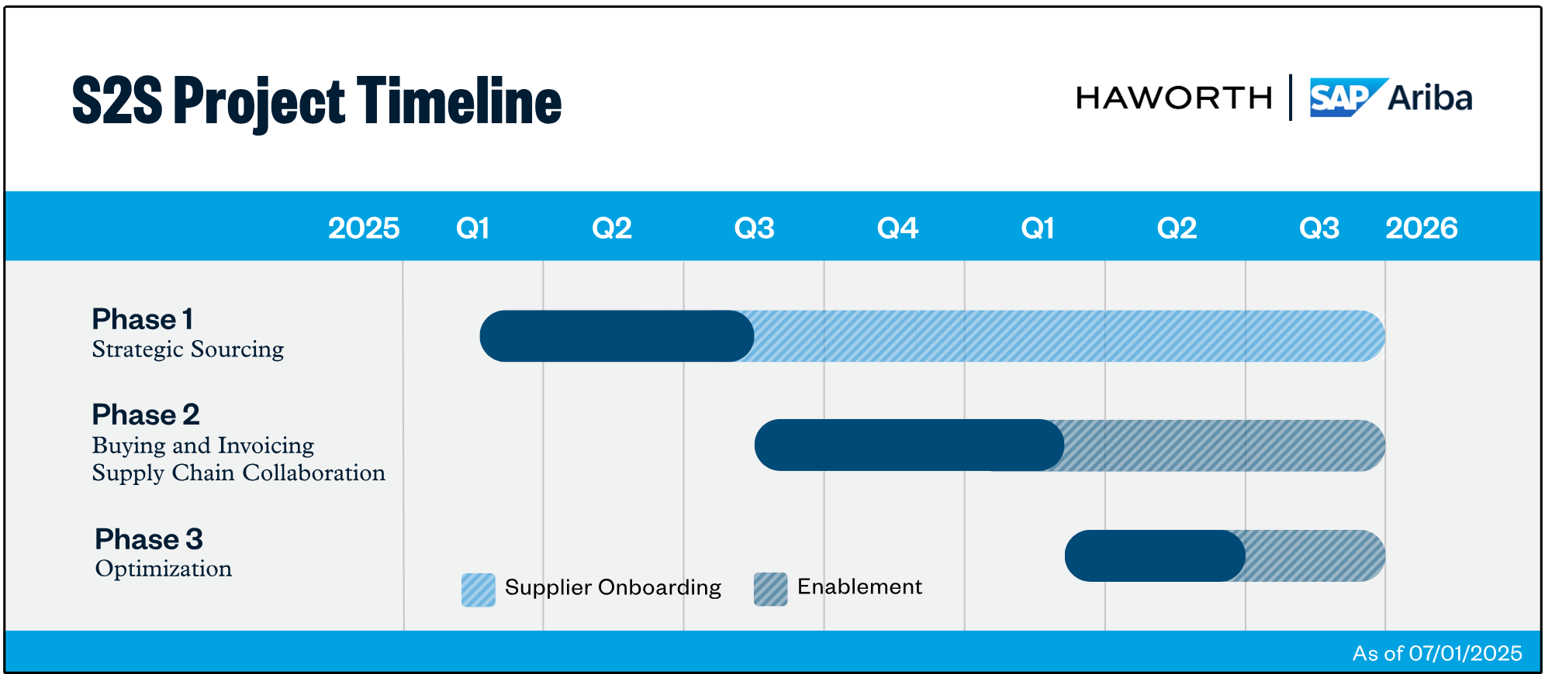

Slide 23
Transition Expectations
Notes:
This section outlines the communication timeline, how suppliers will receive invitations, and the availability of training and support resources throughout the transition.

Slide 24

What to Expect as a Supplier to Haworth
Clear Communication
  Haworth (and our SAP Partner) will provide clear communication to guide suppliers through the onboarding process effectively.
Onboarding Steps and Timelines
  Detailed onboarding steps and timelines will be provided to help suppliers understand and follow the transition smoothly.
Support Resources
  Haworth has partnered with SAP to provide support resources to assist suppliers throughout the transition to ensure a successful onboarding experience.
Notes:
---
Haworth will provide clear, official communications outlining the onboarding steps, timelines, and support resources to assist suppliers throughout the transition process.

Slide 25

Onboarding – Phase 1
Step 1: Pre-Communication sent from Haworth Sourcing Team
Step 2: Invitation Link Email Sent - Includes details to help register SLP
    Ensure correct POC is in the system
    Ensure they have access to the required Information to complete required registration items
    Contact your Commodity Specialist or Supplier Engagement Functional Lead
Step 3: Fill out required information and provide documentation
    Reference Supplier Help Website
    FAQs
    Step 4: Stay motivated and diligent in completing registration!
    Due Prior to Go-Live
Notes:
---
Suppliers should be prepared to receive an invitation email from SAP Business Network, which will contain instructions for account setup or connection to existing accounts.
Image source: Microsoft 365 content library

Slide 26
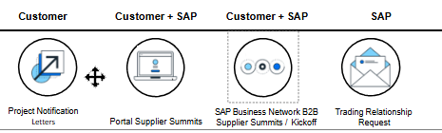
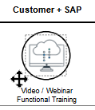
Getting Prepared for Phase II
Comprehensive Training Materials
  Extensive training resources will guide suppliers in mastering the new platform efficiently.
  You will be invited to a summit to receive training
  Support Availability
  Dedicated support will assist suppliers in resolving any questions during onboarding.
  Communication Channels
  Direct emails to Suppliers from Haworth will come from suppliers@haworth.com
  For support, contact us at helpdesk@haworth.com, or call 616.393.4357 or 877.592.5435
  Review Haworth.com for supplier support
Notes:
---
Haworth will provide clear, official communications outlining the onboarding steps, timelines, and support resources to assist suppliers throughout the transition process.
Image source: Microsoft 365 content library

Slide 27

Action Items upon Receiving Haworth and SAP Business Network Emails
Onboarding Emails and Prompt Review
  Suppliers check emails to identify onboarding instructions
    Get Registered!
Follow Onboarding Instructions
  Suppliers should carefully follow provided steps to complete onboarding smoothly.
    Read FAQs and reach out if you have questions
      Seek Assistance When Needed
  For any difficulties, suppliers are encouraged to contact support to avoid transaction delays.
    Reach out to helpdesk@haworth.com
Notes:
---
Suppliers should promptly review the emails, follow the instructions for onboarding, and reach out for assistance if needed to avoid delays in transaction processing.
Image source: Microsoft 365 content library

Slide 28

Key Rollout Dates and How to Stay Informed
Phase 1 (All invites have been sent)
- If you have not received, please reach out to suppliers@haworth.com
- Register ASAP
- On-line Support https://Haworth.com/na/en/about/suppliers.html
Phase 2 (Upcoming)
- Email invite for the SAP Business Network Supplier Summit
- EDI changes may be required
Staying Informed
- Haworth Supplier Site
- Haworth Purchasing Contact
- Technology Update Sessions
- SAP Business Network Supplier Summit
Notes:
Save in your contacts so you know what it is and not a spam email. Phishing.
---
Suppliers should note the important rollout dates and use the provided channels to stay updated on any changes or additional instructions throughout the transition.
Image source: Microsoft 365 content library

Slide 29

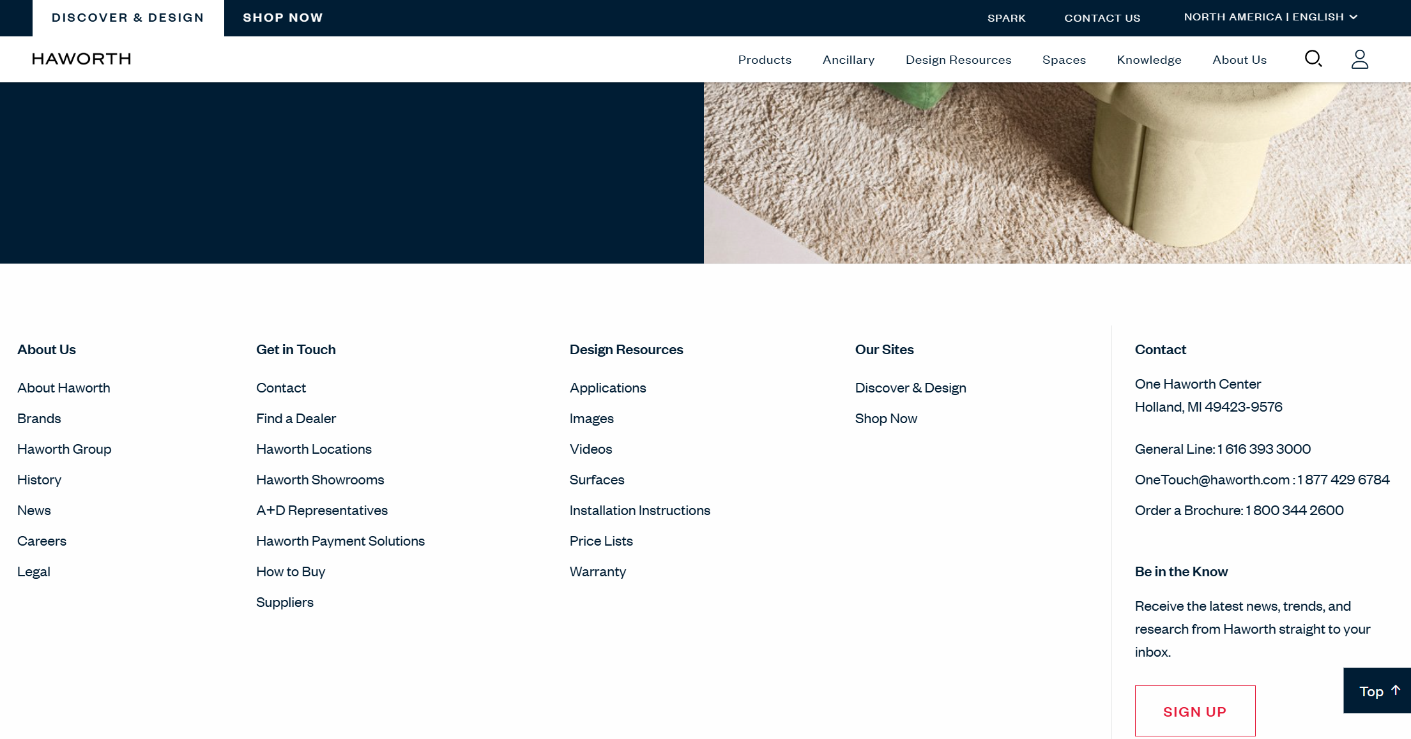
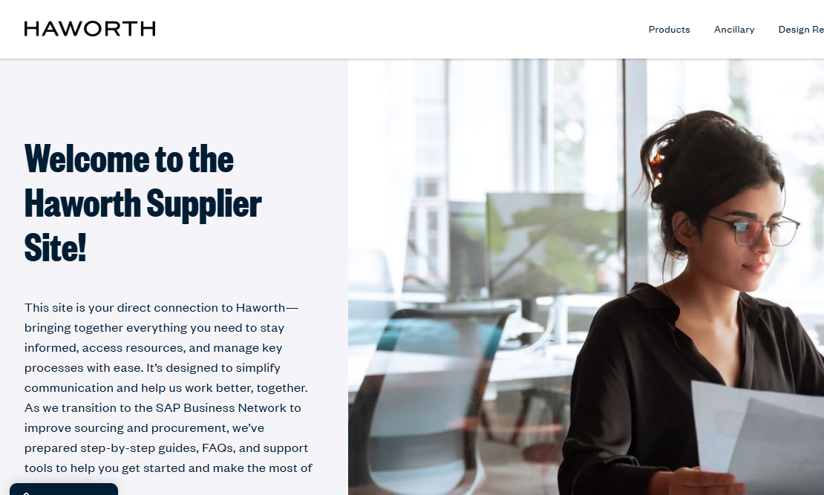
How to Navigate
Haworth.com
Haworth.com
Go to Bottom
Suppliers | Haworth
Notes:
---
Suppliers should note the important rollout dates and use the provided channels to stay updated on any changes or additional instructions throughout the transition.
Image source: Microsoft 365 content library

Slide 30



Summary
Enhanced Supplier Interaction
  The SAP Business Network streamlines supplier processes and improves operational visibility for better collaboration.
Preparation and Engagement
  Suppliers should prepare and stay engaged with ongoing communications to ensure smooth transition.
Utilization of Resources
  Utilizing available resources supports suppliers in adapting to the new SAP Business Network efficiently.
Notes:
Transitioning to SAP Business Network will enhance supplier interactions with Haworth by streamlining processes and improving visibility. Suppliers are encouraged to prepare, stay engaged with communications, and utilize available resources for a successful transition.

